Slide 1

NSG Pilkington – University of Liverpool Machine Learning Project: 20/01/2021
Dr. Peter Green
Diego Echeverria
Risk Institute,
School of Engineering

Slide 2



Recursive Model Structure
Two sets of data.
Cross-validation; reverse the role of training and test data before calculating the average performance on test data.
Our second data set looks less ‘eventful’ than the first.
From now on we will compare out interpretable models with a Gaussian Process.
Haven’t incorporated additional data from Mark at this point.
We start by using the first set of data for training, and the second set of data for testing.
$${\hat{y}}_{t+1}=f_{1}(y_{t}, x)$$
$${\hat{y}}_{t+2}=f_{2}({\hat{y}}_{t+1}, x)$$
$${\hat{y}}_{t+3}=f_{3}({\hat{y}}_{t+2}, x)$$

Slide 3
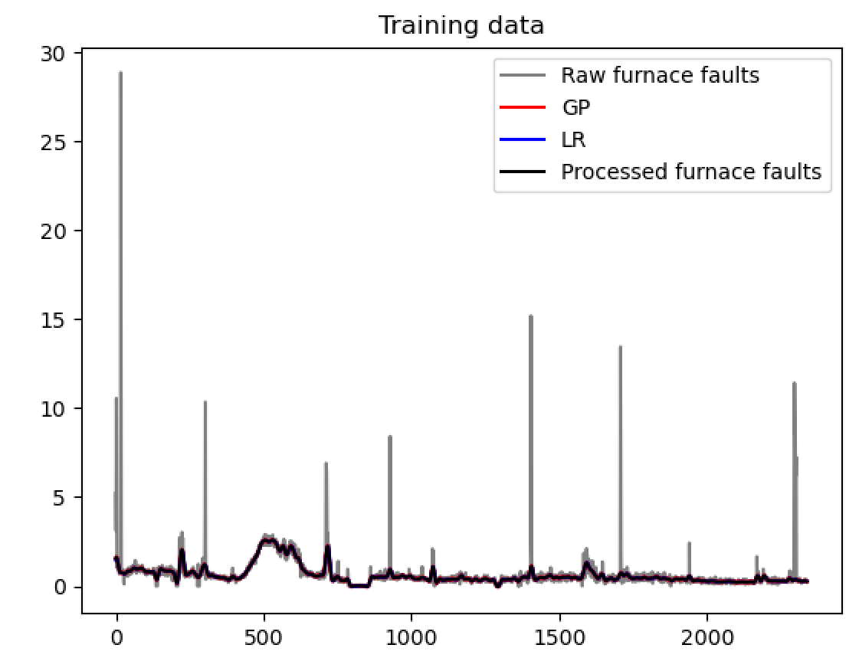
Case 1

Slide 4
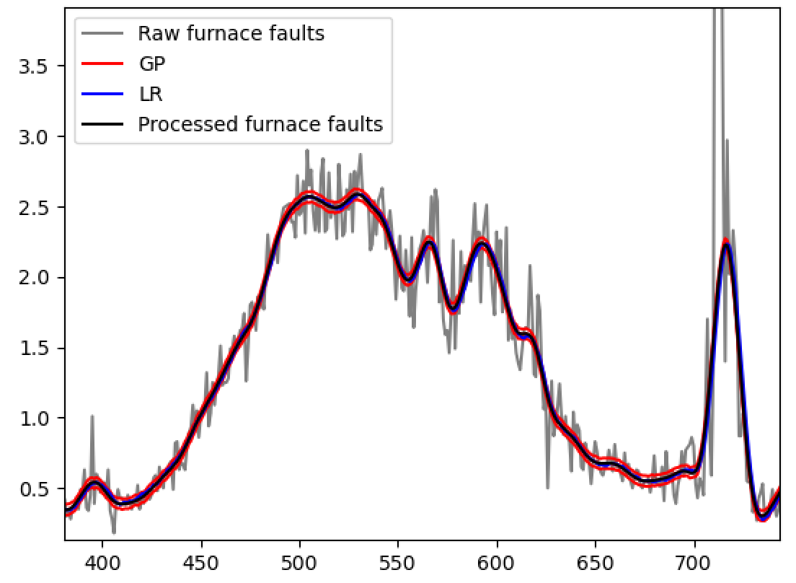
Both models look good (they should do)
Encouraging to see that the linear regression model is so close to the Gaussian Process.
Case 1

Slide 5
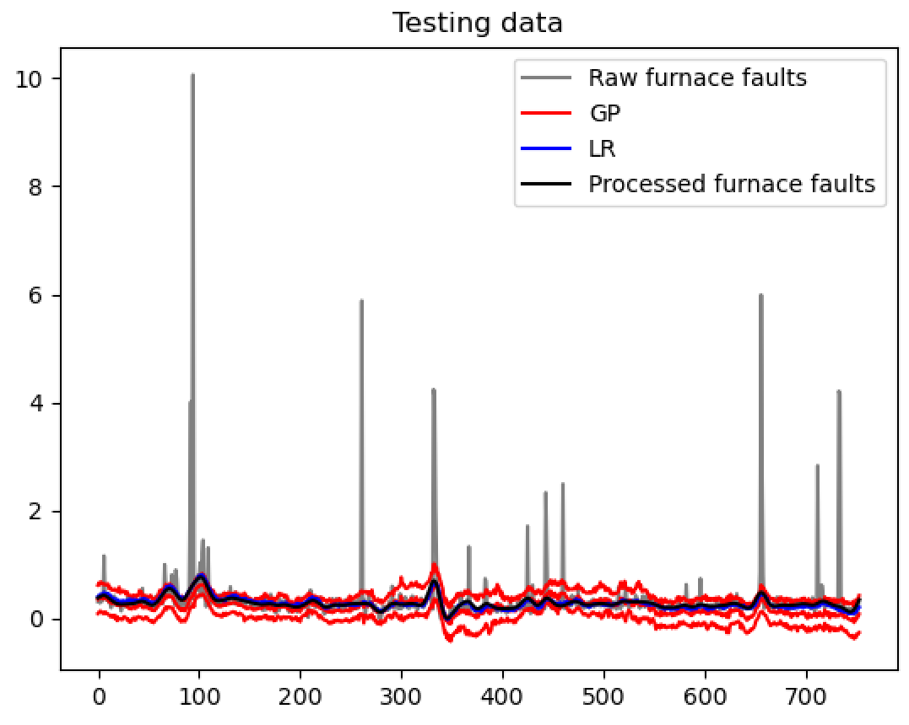
Case 1

Slide 6
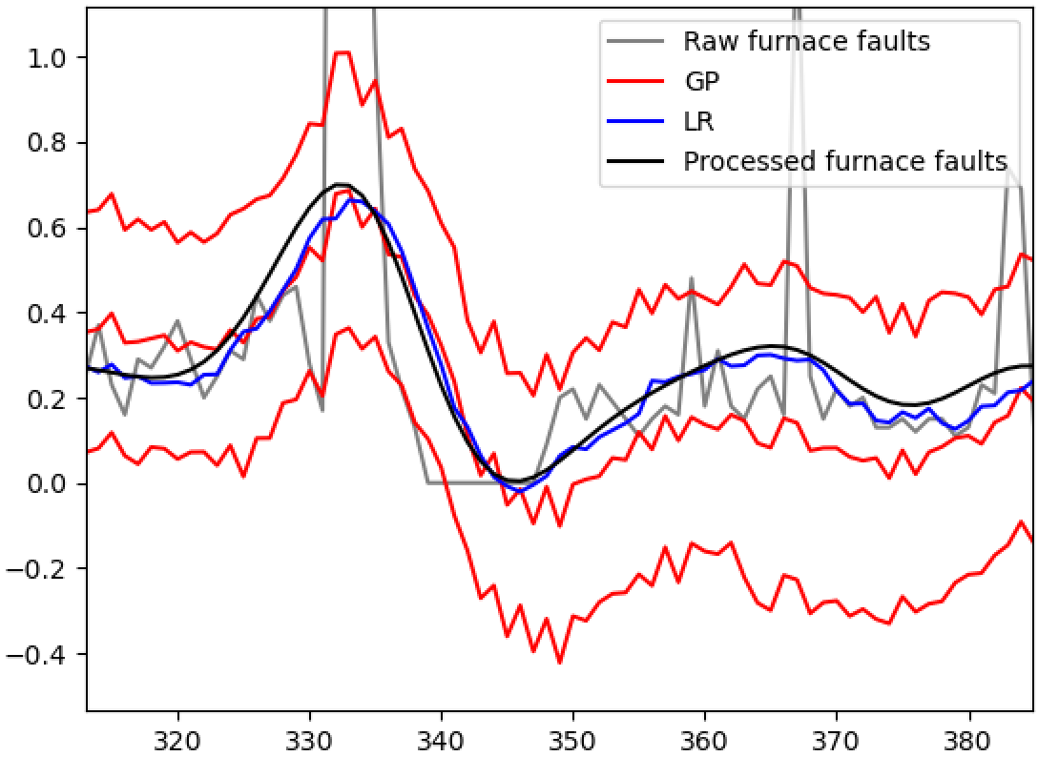
Both fairly close; encouraging
Not a huge obvious difference between Linear Regression and GP; also encouraging
But want to avoid ‘lagged predictions’ in the Linear Regression model.
Predictions still noisy; bespoke filtering to be analysed in future work.
Case 1

Slide 7
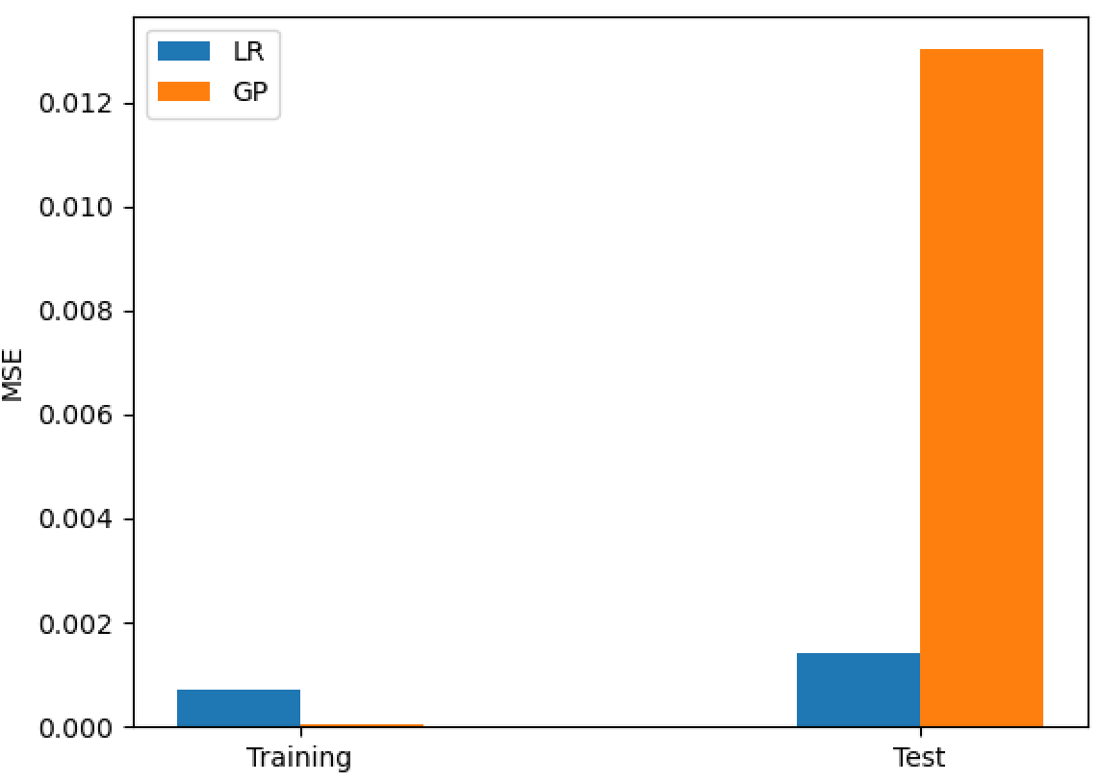
 | LR | GP
Training (1) | 70.0e-5 | 2.8e-5
Test (1) | 0.0014 | 0.0130
Training (2)
Test (2)
Score
Interesting that the GP wins on training data but loses on test data; a classic example of overfitting.
Next we reverse the roles of the training and test data…

Slide 8
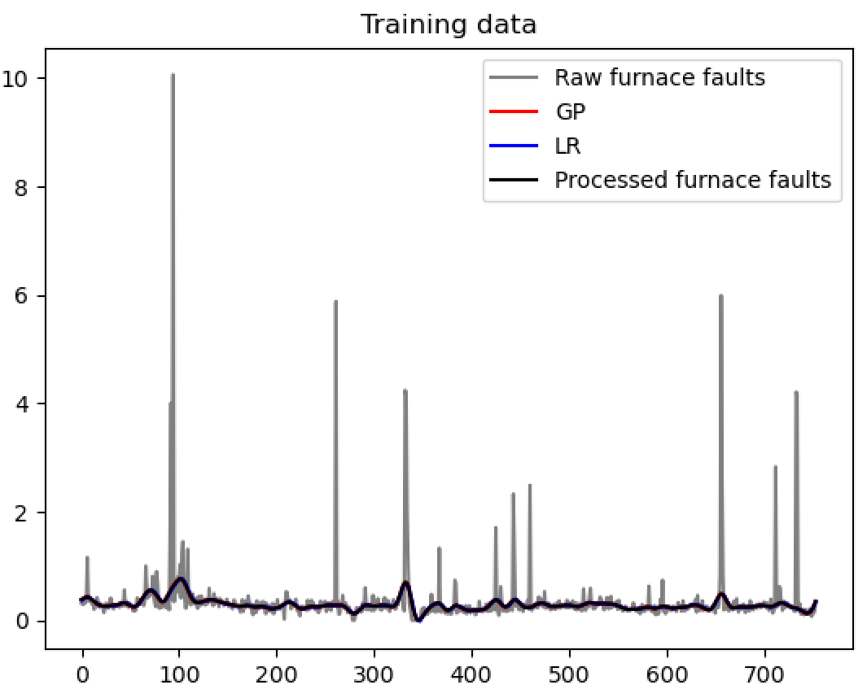
Case 2

Slide 9
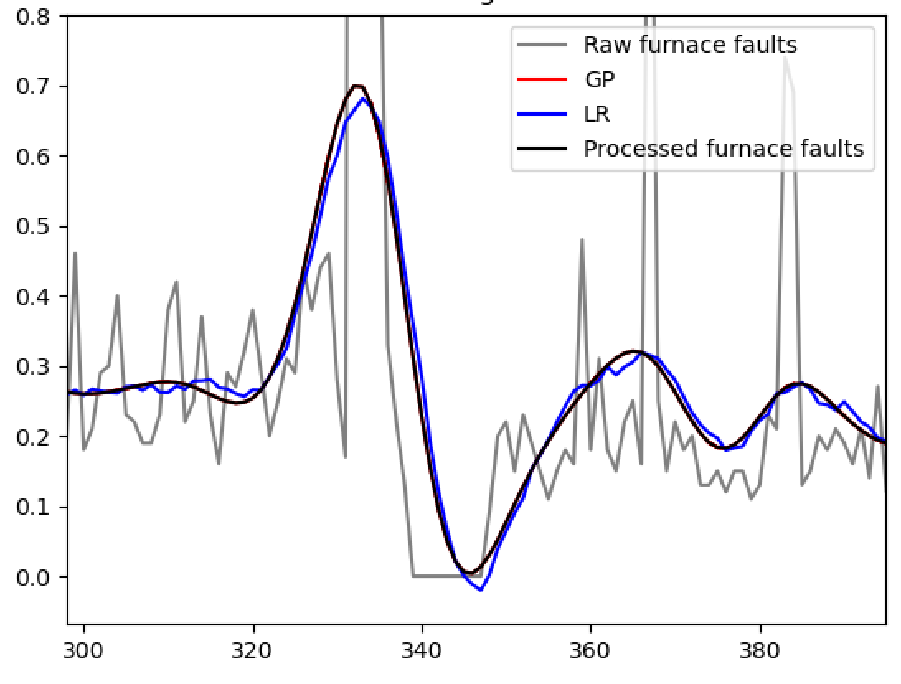
Very good fit from both models (as we would expect)
Case 2

Slide 10
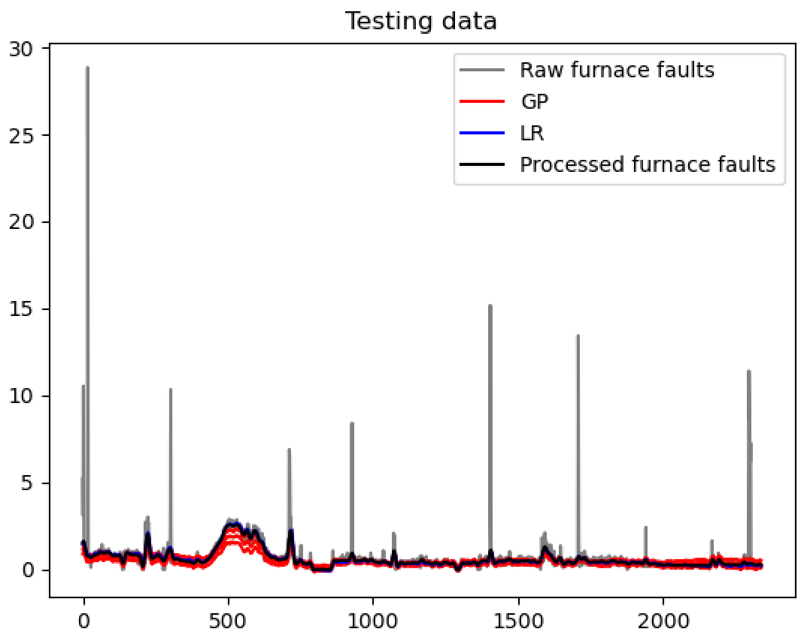
Case 2

Slide 11
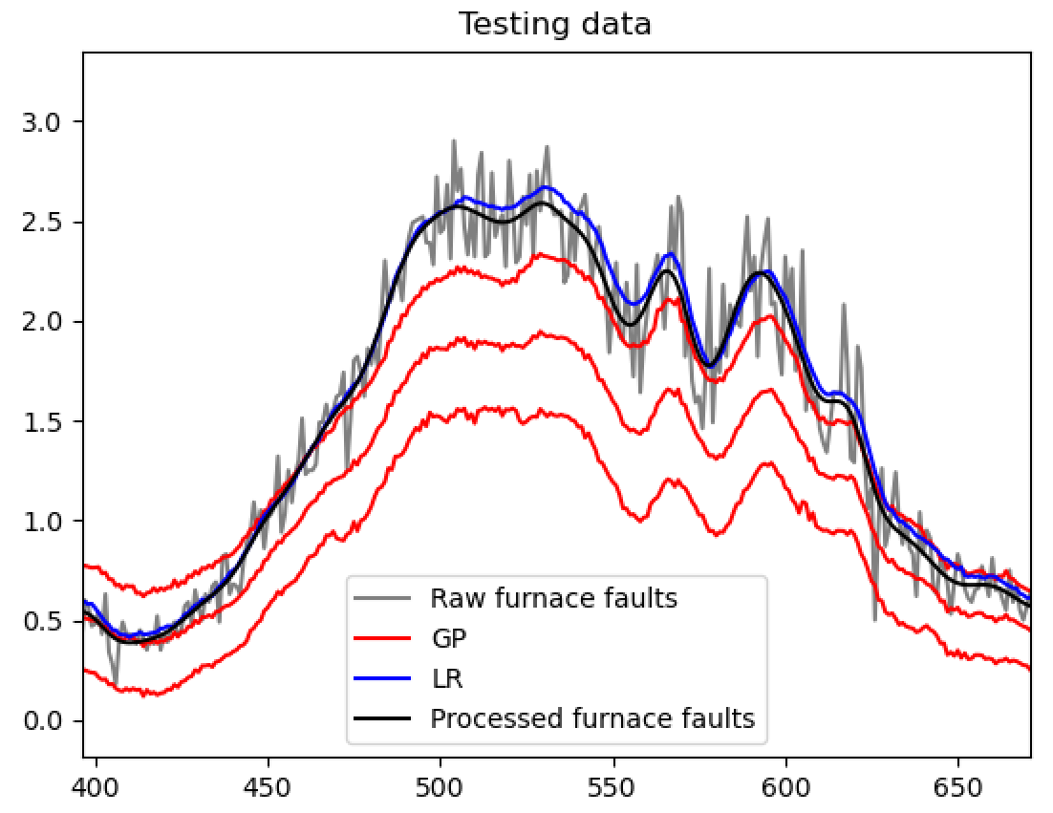
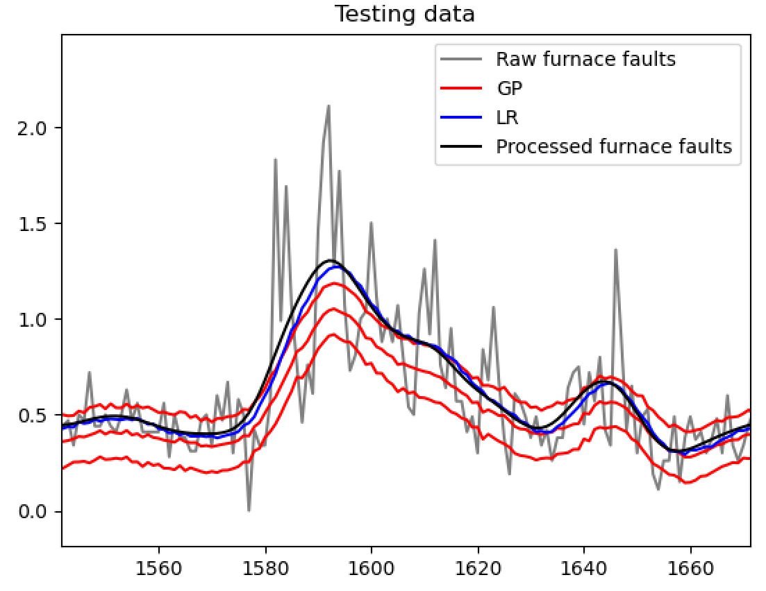
Case 2

Slide 12
No lag from the linear regression model here, which is encouraging.
But we can see the lag here.
Case 2

Slide 13
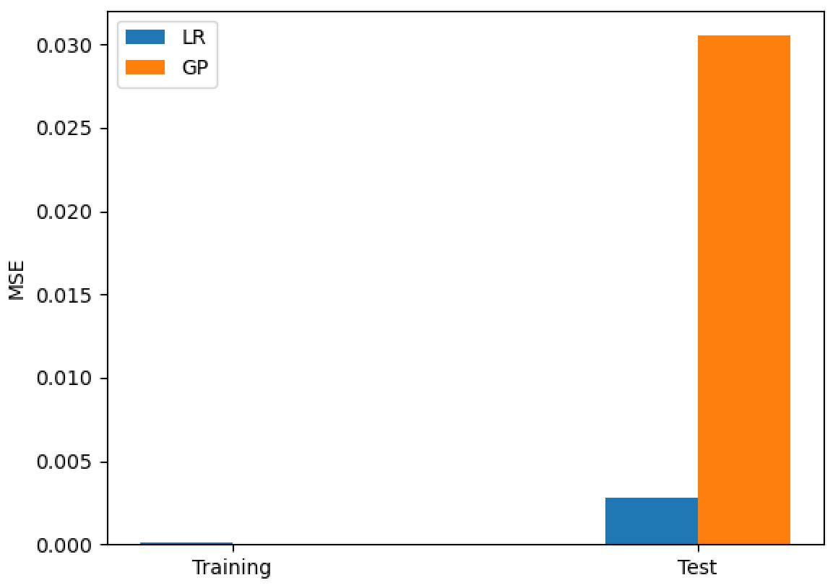
 | LR | GP
Training (1) | 70.0e-5 | 2.8e-5
Test (1) | 0.0014 | 0.0130
Training (2) | 12.0e-5 | 7.9e-21
Test (2) | 0.0027 | 0.031
Score

Slide 14
 | LR | GP
Training (1) | 70.0e-5 | 2.8e-5
Test (1) | 0.0014 | 0.0130
Training (2) | 12.0e-5 | 7.9e-21
Test (2) | 0.0027 | 0.031
Score | 0.00205 | 0.0220

Slide 15
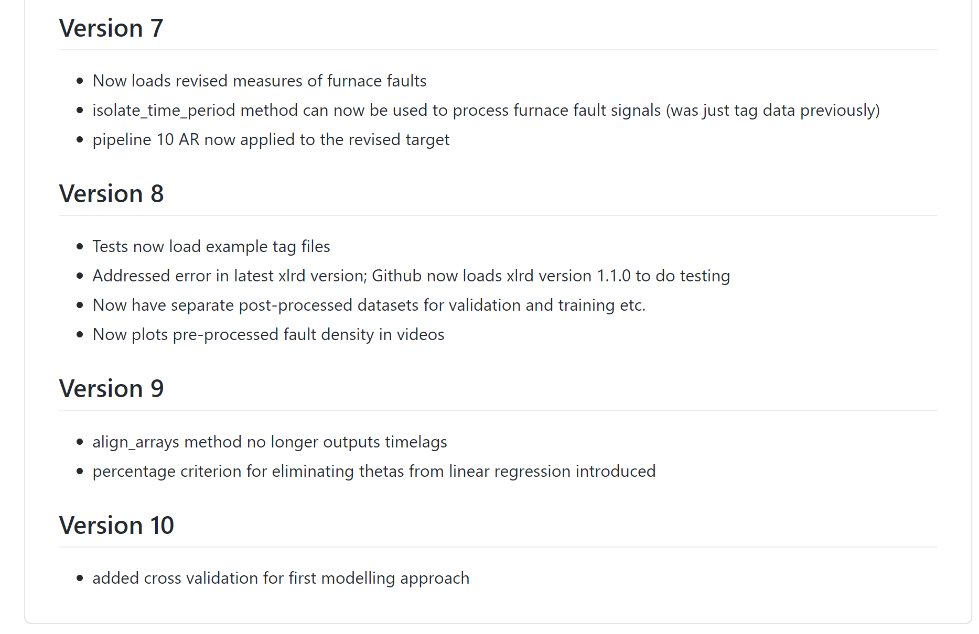
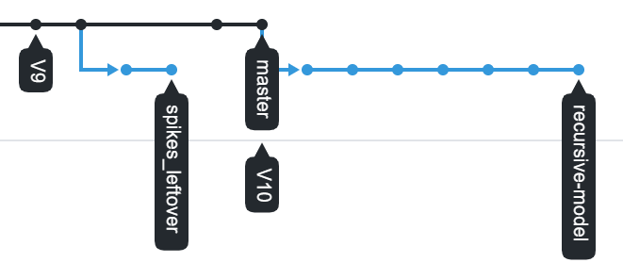
Previously we have plotted model performance against iteration of data pipeline.
Now we will be making changes to the pipeline & model etc.
We have our own ‘version history’ for the code; should align to this from now on?

Slide 16
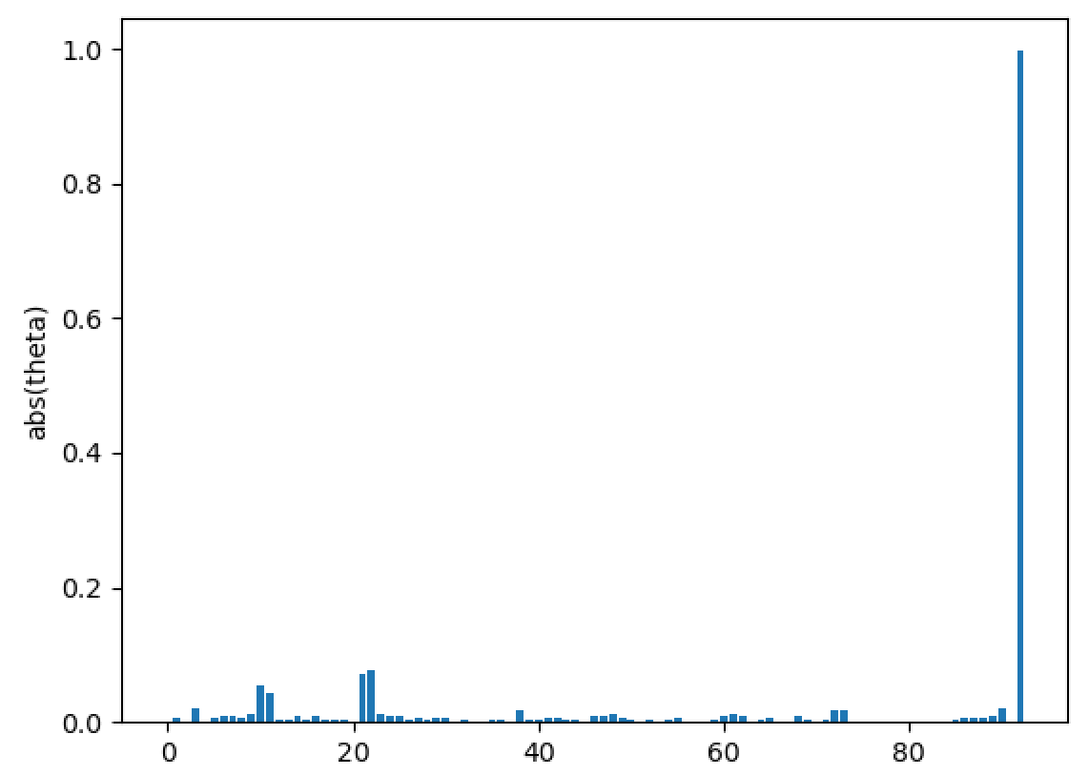
Key Inputs (Linear Regression): case 1

Slide 17
Key Inputs (Linear Regression): case 1
Autoregressive input

Slide 18
Key Inputs (Linear Regression): case 1
Zoom in

Slide 19
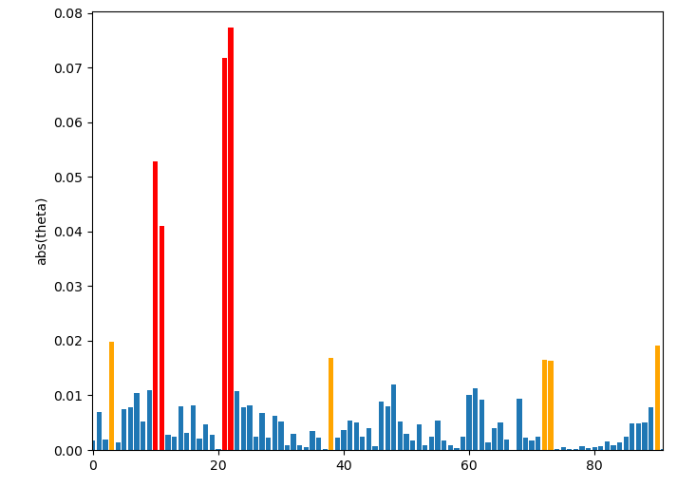
Key Inputs (Linear Regression): case 1
Inputs:
2913 Closed Bottom Temperature - Port 1 (PV)
2914 Closed Bottom Temperature - Port 2 (PV)
11152 D/S Working End Cooling Air Flow Control Right (OP)
1728 D/S Working End Cooling Air Flow Control Right (PV)
10278 Canal Temp. Control (OP)
9393 Glass Level Control (OP)
100003 Port 6 - 7 Combustion Air Flow (combined)
6585 Port 6 Gas Flow (PV)
100018 Regenerator Crown Temperature Port 8 (combined)

Slide 20
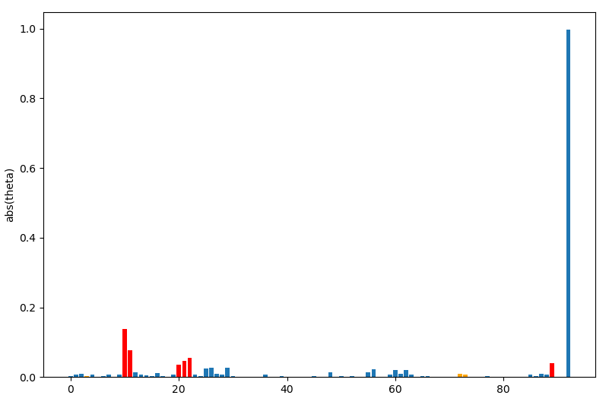
Key Inputs (Linear Regression): case 2
Autoregressive input

Slide 21
Key Inputs (Linear Regression): case 2
Zoom in

Slide 22
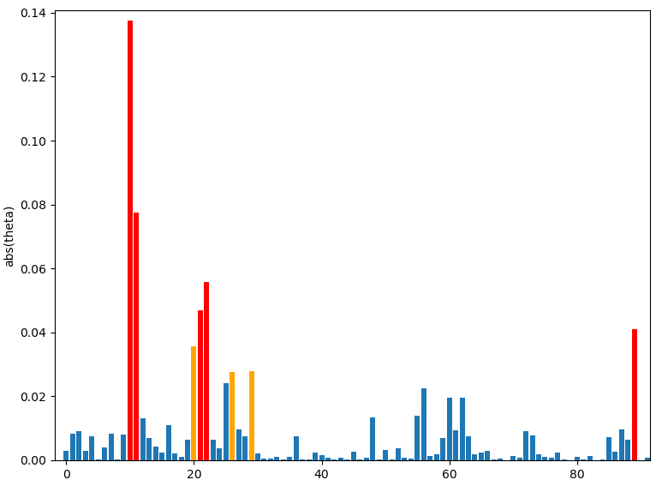
Key Inputs (Linear Regression): case 2
Inputs:
2913 Closed Bottom Temperature - Port 1 (PV)
2914 Closed Bottom Temperature - Port 2 (PV)
11152 D/S Working End Cooling Air Flow Control Right (OP)
1728 D/S Working End Cooling Air Flow Control Right (PV)
15070 Regenerator Crown Temperature Port 6 RHS
1727 D/S Working End Cooling Air Flow Control Left (PV)
2923 Filling Pocket Closed Bottom Temperature Centre (PV)
5288 Front Wall Cooling Air Flow (PV)

Slide 23
Key Inputs (Linear Regression): case 2
common
Inputs:
2913 Closed Bottom Temperature - Port 1 (PV)
2914 Closed Bottom Temperature - Port 2 (PV)
11152 D/S Working End Cooling Air Flow Control Right (OP)
1728 D/S Working End Cooling Air Flow Control Right (PV)
15070 Regenerator Crown Temperature Port 6 RHS
1727 D/S Working End Cooling Air Flow Control Left (PV)
2923 Filling Pocket Closed Bottom Temperature Centre (PV)
5288 Front Wall Cooling Air Flow (PV)

Slide 24
Pre-processing tasks
Remove remaining points from the spikes.

Slide 25
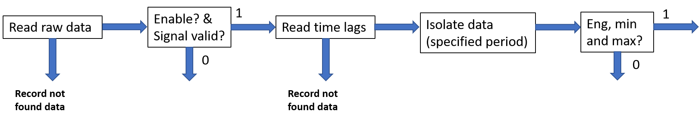
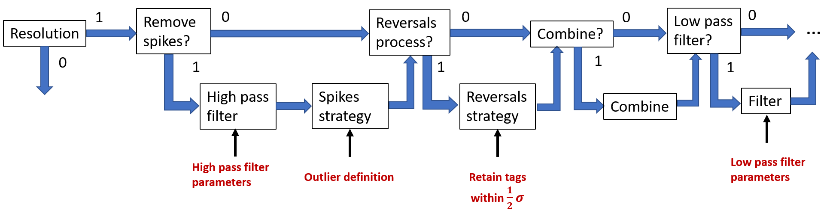
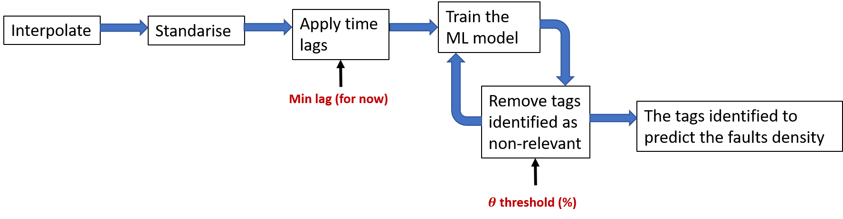

Slide 27
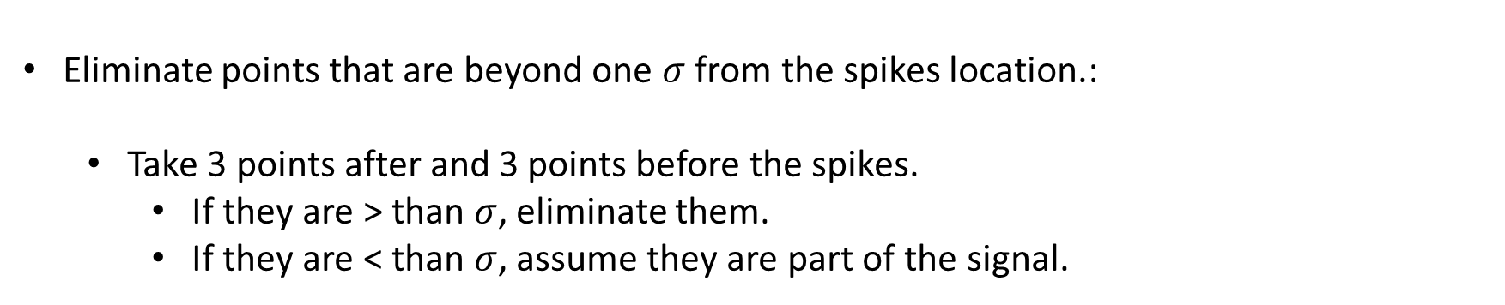
Eliminating left over points from the spikes removal process
Eliminate points that are beyond one $σ$ from the spikes location.:
Take 3 points after and 3 points before the spikes.
If they are > than $σ$, eliminate them.
If they are < than $σ$, assume they are part of the signal.

Slide 28
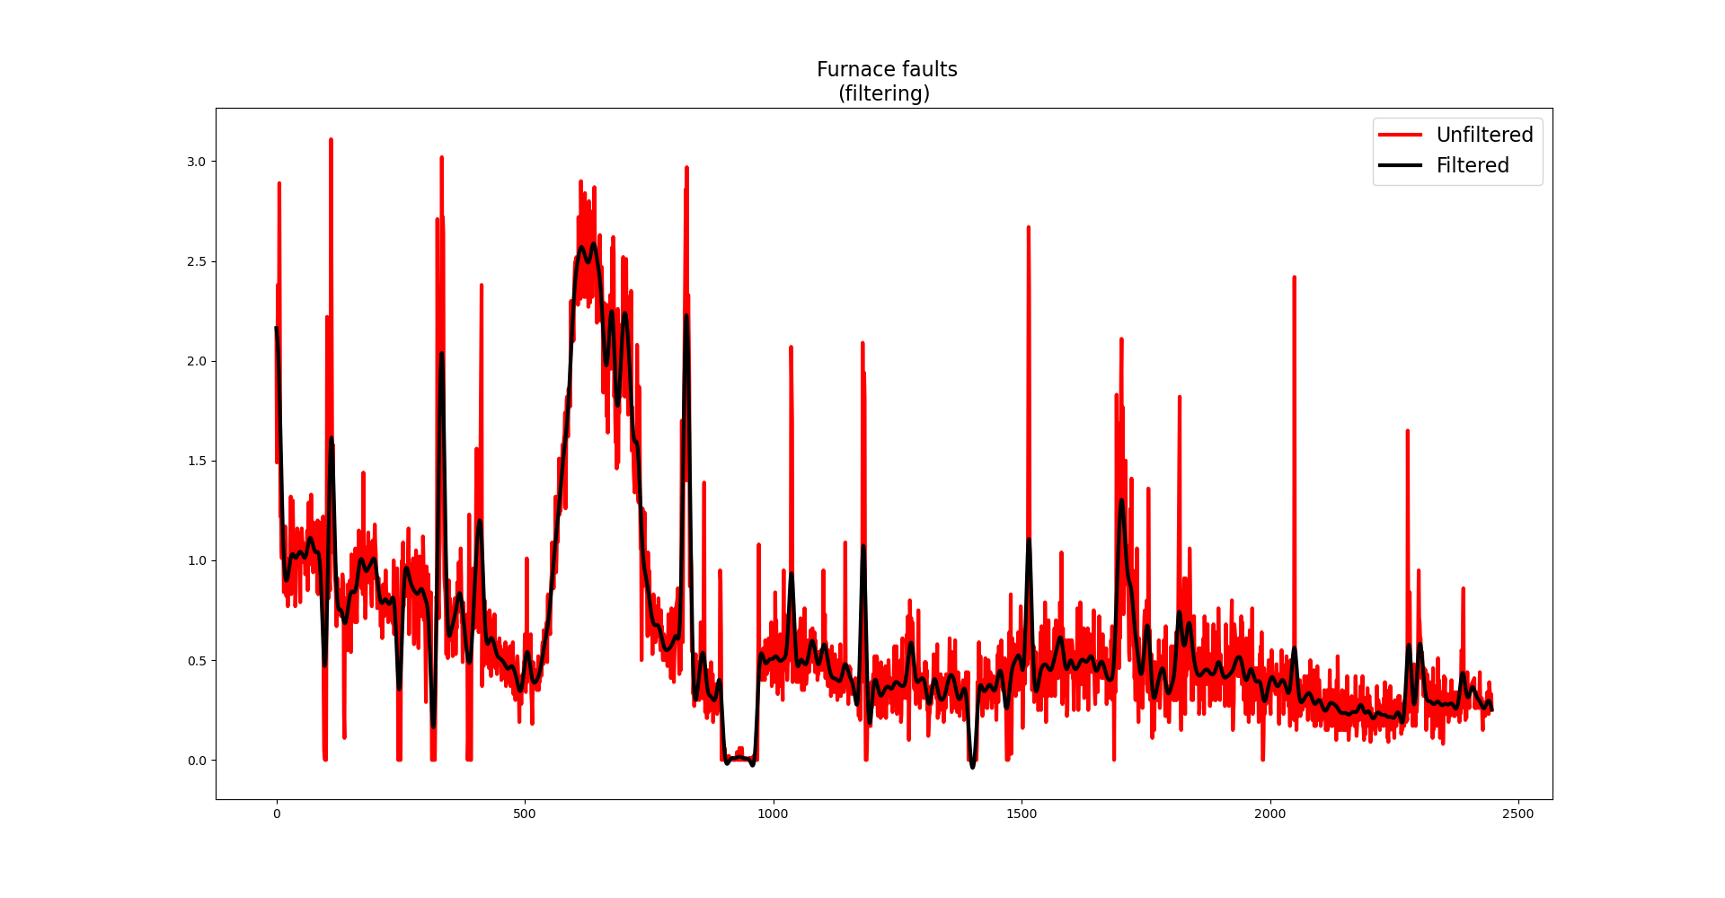
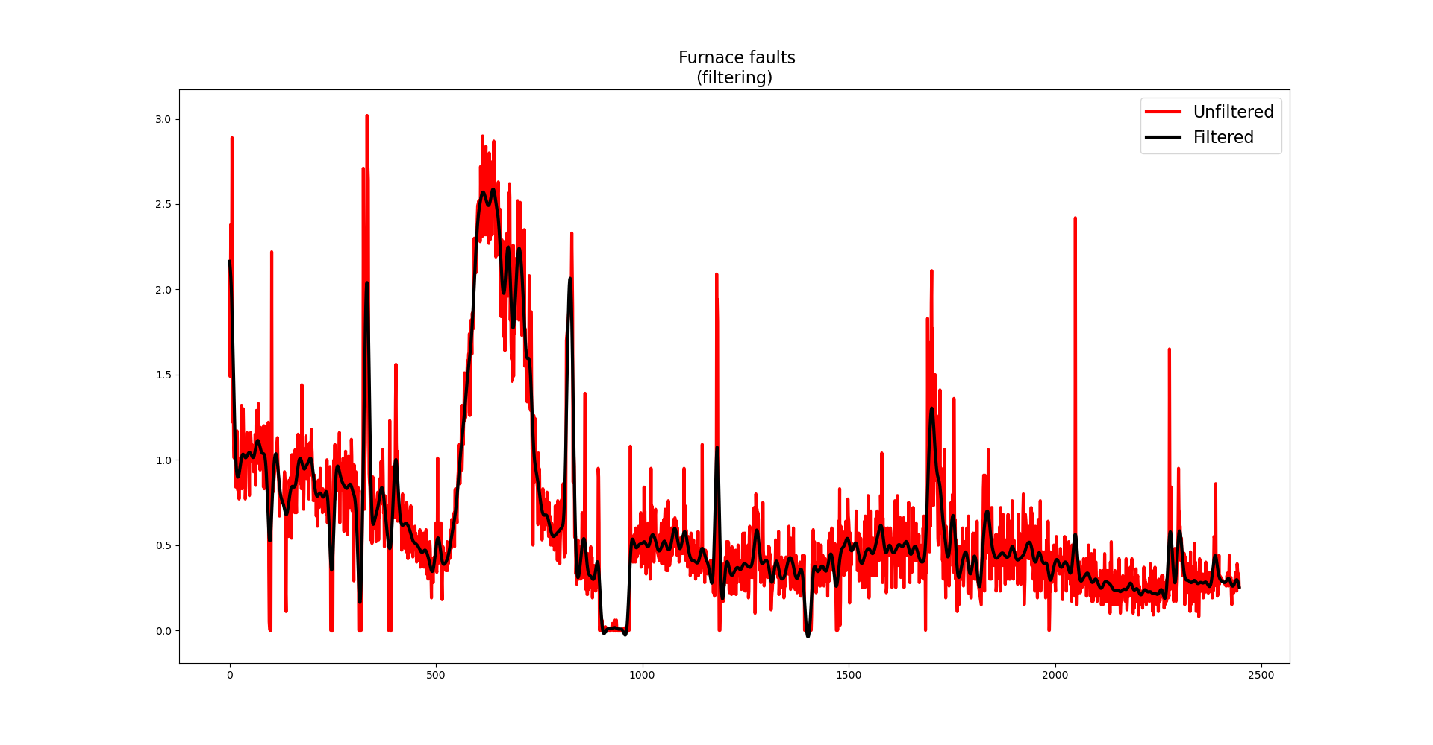
Comparison
Red line: Spikes removed
Red line: Spikes and left over points removed.

Slide 29
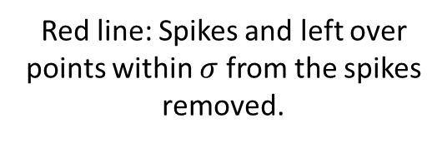
Comparison
Red line: Spikes removed
Red line: Spikes and left over points within $σ$ from the spikes removed.

Slide 30
Thank you for your attention. ANY QUESTIONS?

